Slide 1


ENGINEERING CAPSTONE PROJECT – 1/INDUSTRIAL INTERNSHIP/ INDUSTRIAL INTERNSHIP PHASE-I
Project Review-3
An Extensible Personal Finance Management Framework for Expense Tracking, Visual Analytics, and Intelligent Decision Support
Team No-9
Roll No Name
2320030368 Sneha Mithra
Under the Guidance of
Dr. K Swapnika
Department of Computer Science and Engineering
KONERU LAKSHMAIAH EDUCATION FOUNDATION

Slide 2
OUTLINE
Introduction
Problem Statement
Objectives
Literature Survey
Research Gap Identification
Innovation, Creativity, and Novelty
Feasibility and Project Plan

Slide 3
Introduction
1. Background of the Topic
Nowadays, people use different payment methods such as UPI, debit/credit cards, cash, and online shopping. Because transactions happen frequently across multiple platforms, keeping track of income and expenses has become difficult. Fintrack is designed to bring all these financial activities together in one place and make money management easier.
2. Importance of the Project
Managing money is an important part of everyday life. Fintrack helps users understand where their money goes, monitor their spending habits, and plan their budgets. It presents financial information through simple dashboards and visual charts, helping users make better financial decisions.
3. Problem Statement
Many people find it difficult to maintain a clear record of their daily expenses and income. Financial information is often scattered across different payment methods, making it hard to identify unnecessary spending or follow a budget. Fintrack aims to solve this problem by providing a centralized platform for tracking transactions, analysing spending patterns, and managing budgets.
4. Applications
Personal Expense Tracking: Record daily income and expenses in one place.
Budget Management: Set budgets and monitor spending limits.
Visual Analytics: View spending patterns through charts and dashboards.
Financial Alerts: Receive alerts about budgets and upcoming expenses.
Better Decision-Making: Use spending insights to develop better saving habits.
Future Enhancements: Support intelligent recommendations, expense prediction, and unusual spending detection.
Fintrack aims to turn everyday financial records into meaningful insights, helping individuals manage their money with greater clarity and confidence.

Slide 4
Problem Statement
Existing personal finance management systems offer features such as expense tracking and budgeting, but users still face difficulties in understanding their spending patterns and making informed financial decisions. Financial records are often scattered across different payment methods, making it challenging to monitor income, expenses, and savings.
Based on the literature survey, there is a need for an integrated system that combines expense tracking, visual analytics, budget management, and intelligent decision support. Fintrack aims to address this gap by providing a centralized platform that helps users track transactions, analyse spending habits, manage budgets, and make better financial decisions.

Slide 5
Objectives
To develop a user-friendly framework for systematic income and expense tracking.
To integrate visual analytics and spending-pattern analysis for meaningful financial insights.
To enhance traditional expense tracking with personalized budgeting, alerts, and intelligent decision support.
To develop an extensible modular architecture for incorporating future financial analytics and recommendation features.
To evaluate the proposed framework based on usability, analytical accuracy, visualization effectiveness, and usefulness of financial insights.

Slide 6
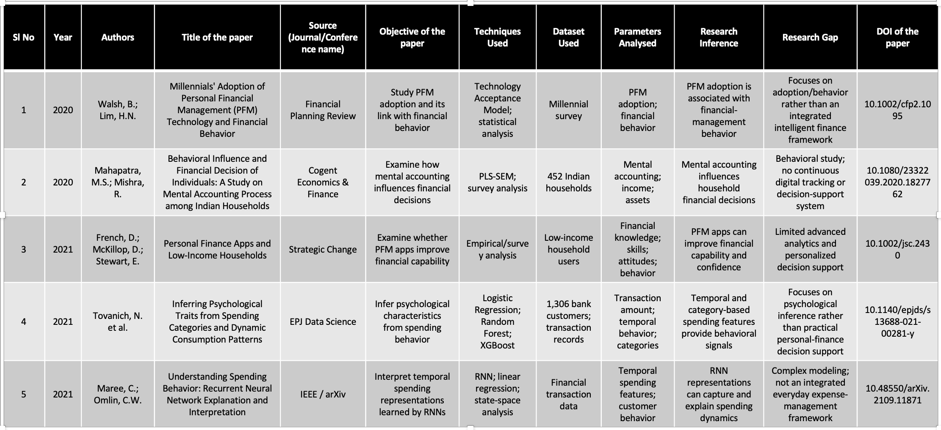
Literature Survey
This slide may include:
Existing methods
Research gap
Why your approach is needed
Mention 15-20 papers/Existing project that are most relevant to your project in the provided format(Preferably 2020 onwards papers):

Slide 7
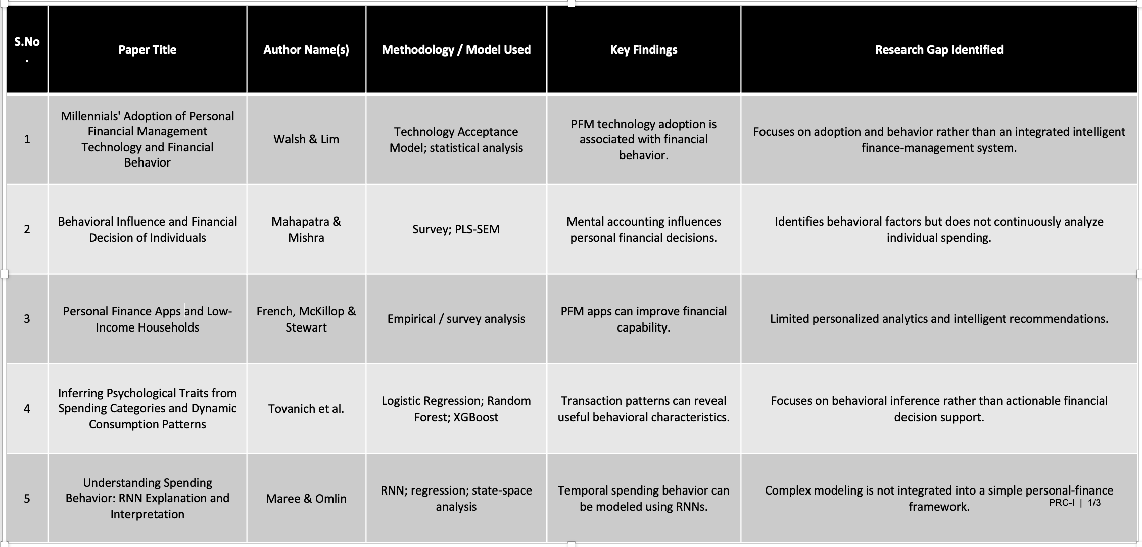
Research Gap Identification
Research gap identification involves analyzing existing literature to identify limitations, unresolved issues, or areas that have not been adequately explored. The identified gap provides the basis for defining the research problem and developing the proposed research work.
S.No. | Paper Title | Author Name(s) | Methodology / Model Used | Key Findings | Research Gap Identified
1 | Title of Research Paper | Author Name(s) | CNN / Transformer / Machine Learning / etc. | Main result or contribution | Clearly mention the limitation or unresolved problem

Slide 8
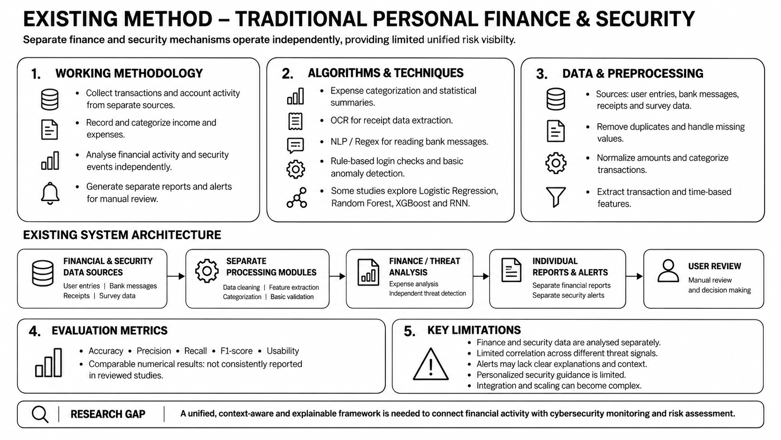

Slide 9
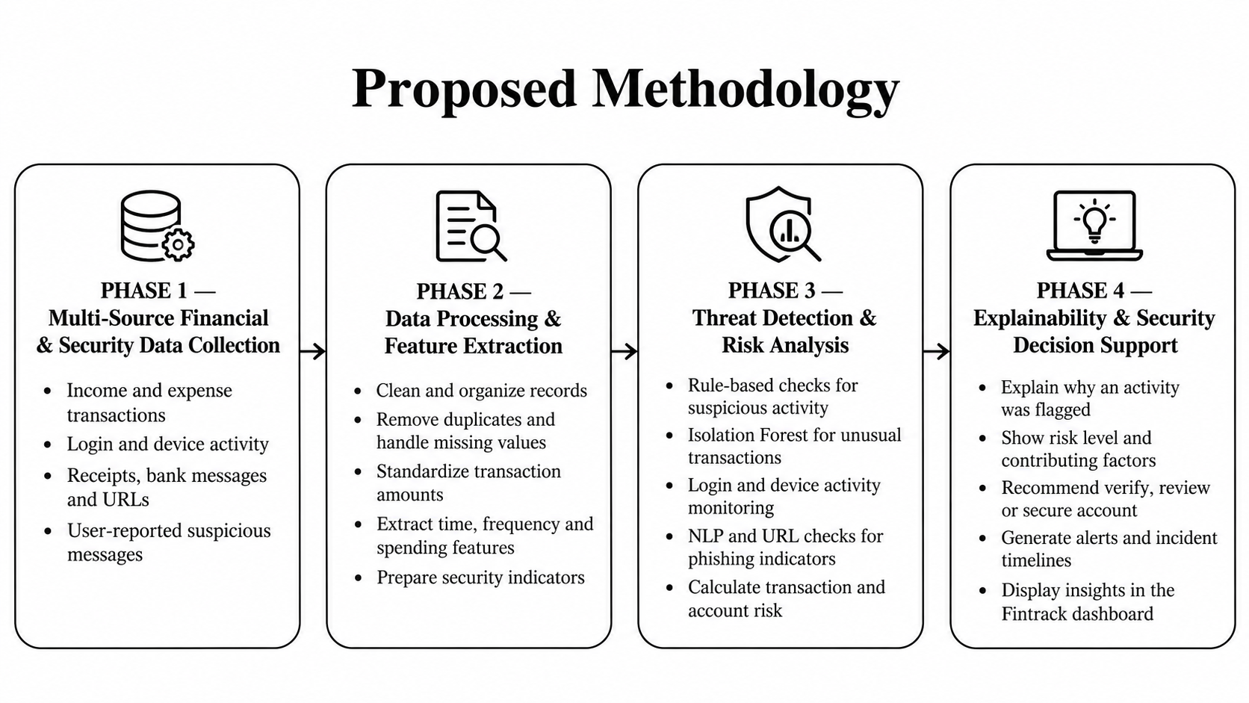

Slide 10
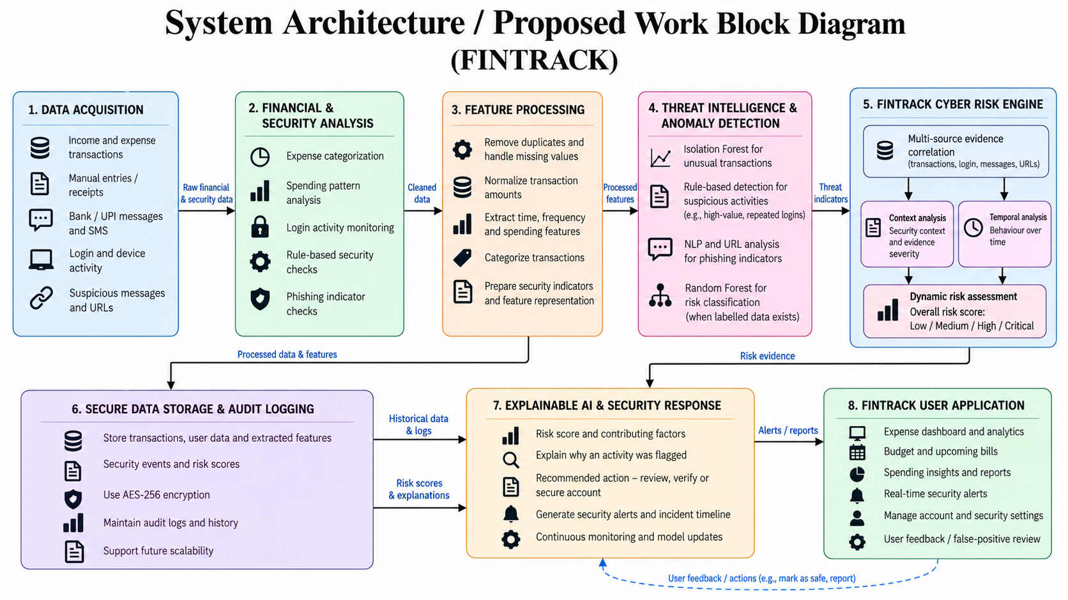

Slide 11
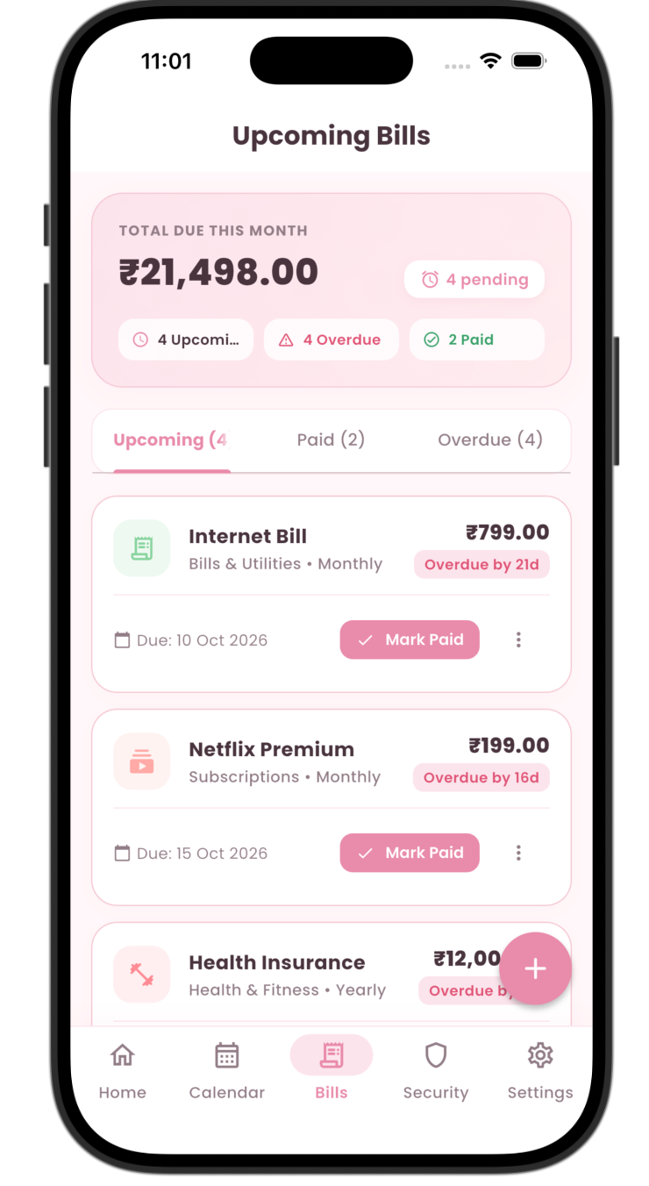
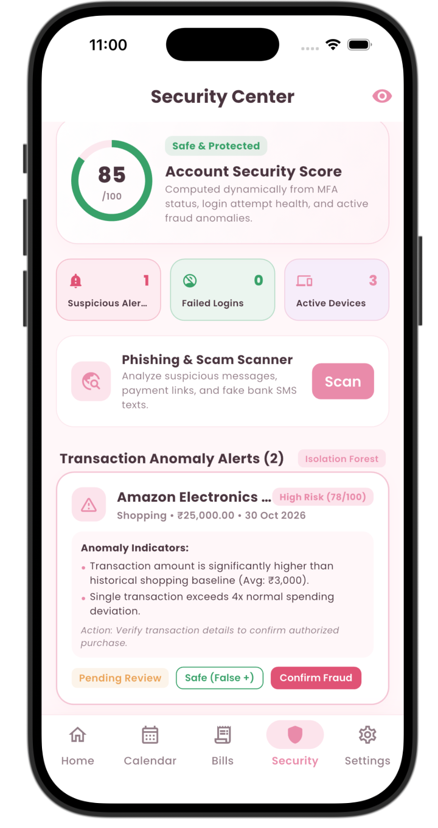
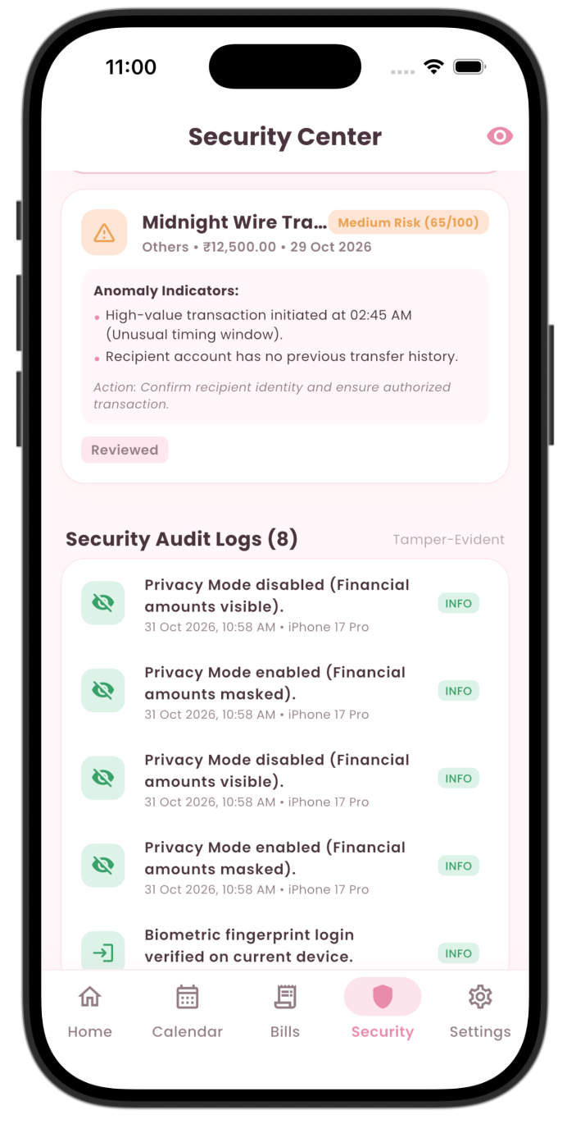
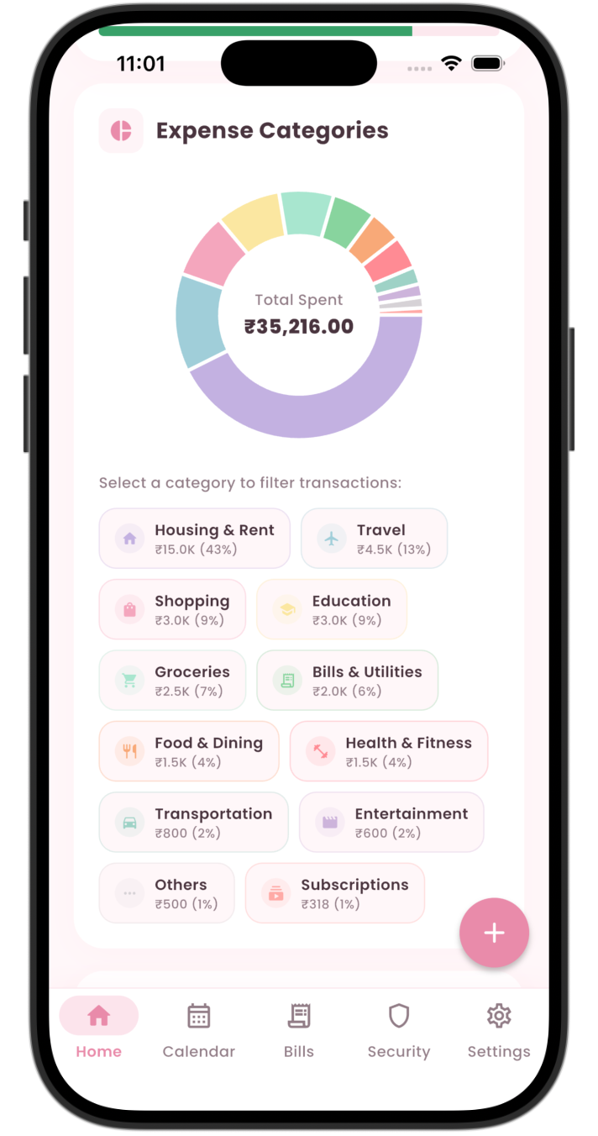
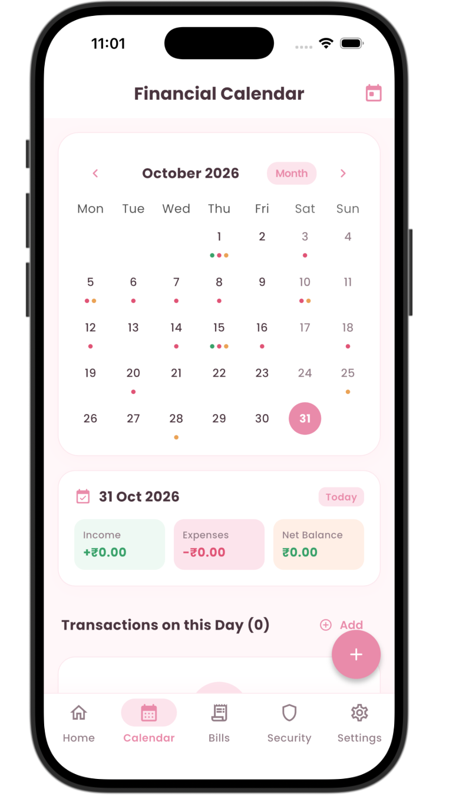
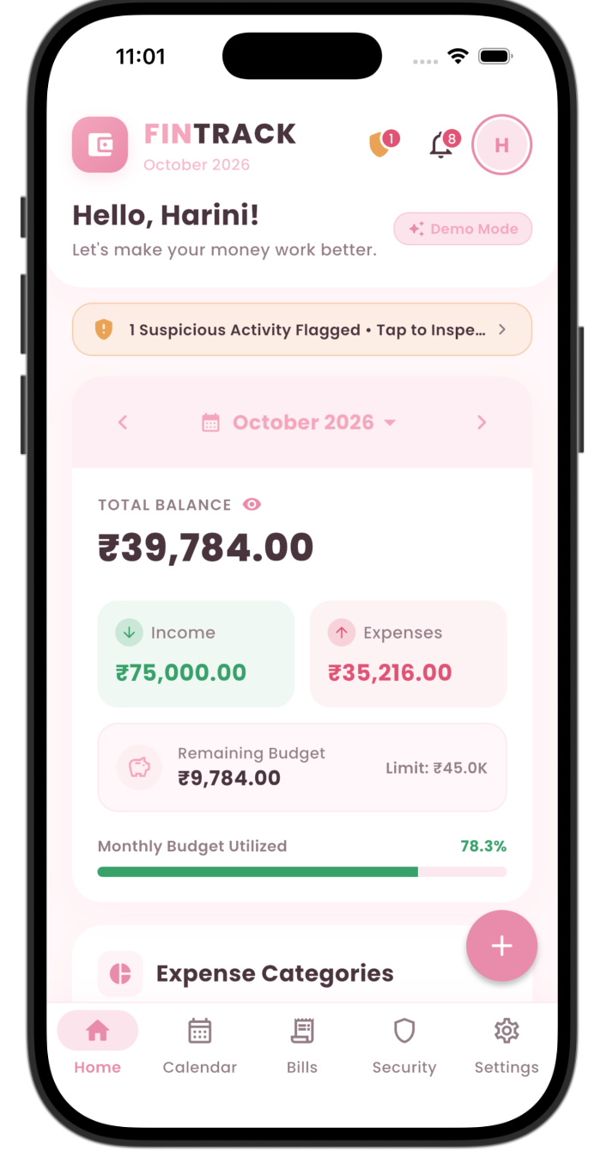
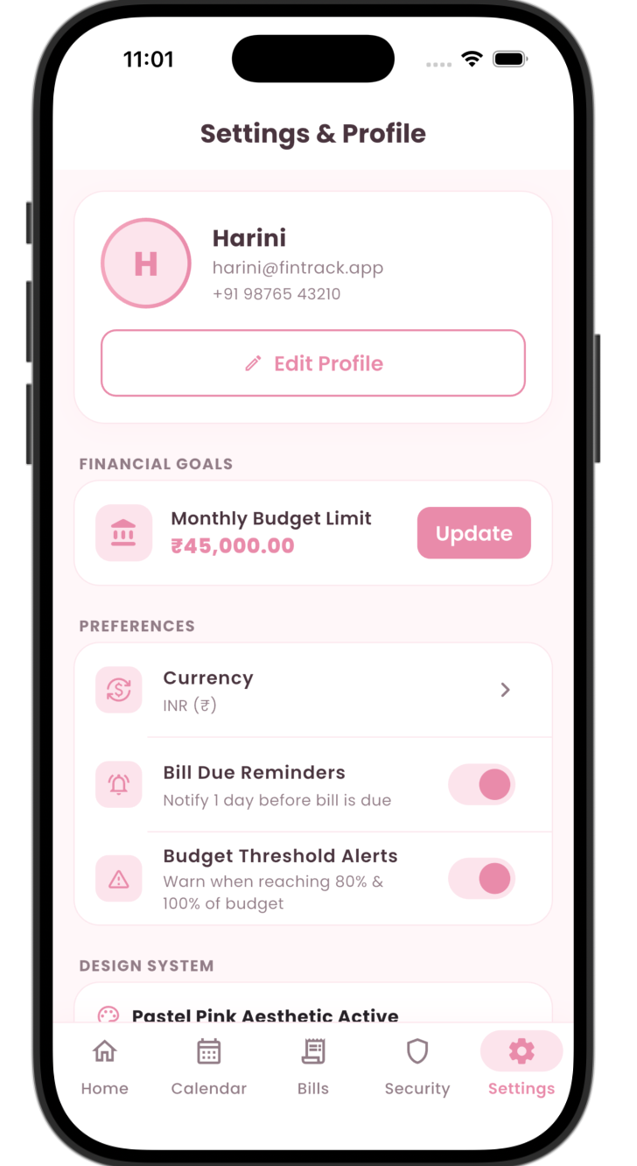
Results & Discussion

Slide 12
Conclusion
1. Summary of the Proposal
Proposed Fintrack, a smart personal finance application that combines expense management with cybersecurity features.
Developed an integrated approach to track financial activities and monitor suspicious transactions and login attempts.
Used Isolation Forest and rule-based techniques to identify unusual spending patterns and potentially risky activities.
Added explainable AI to help users understand why a particular activity is marked as suspicious.
Designed a Cyber Risk Engine to assess threats, generate alerts, and suggest suitable security actions.
Included data encryption, secure storage, and activity logs to improve the protection of users' financial information.
2. Next Steps – Future Work
Complete Development: Finish integrating all finance management and security features.
Dataset Testing: Test the system using synthetic or anonymized financial transaction data.
Detection Evaluation: Check how effectively the system identifies unusual transactions, suspicious logins, and phishing attempts.
Performance Testing: Measure precision, recall, F1-score, false alarms, and detection time.
Security Testing: Check authentication, encryption, and protection against unauthorized access.
Improve Explainability: Make sure users can easily understand why a security alert is generated.
Future Enhancements: Add behavioural analysis, financial attack timelines, and personalized security suggestions.
Final Deployment: Complete application testing, documentation, and final demonstration.

Slide 13
References
1. Financial Fraud: A Review of Anomaly Detection Techniques and Recent Advances
2. Isolation Forest – IEEE Research Paper
3. A Unified Approach to Interpreting Model Predictions (SHAP)
4. A Comprehensive Survey of AI-Enabled Phishing Attacks Detection Techniques
5. Advanced Encryption Standard (AES) – NIST
6. Digital Identity Guidelines: Authentication – NIST
7. OWASP Application Security Verification Standard (ASVS)
8. Guide to Computer Security Log Management – NIST

Slide 14
THANK YOU

